Slide 1



$$\overline{x}$$
MeanShift
Consumer Finance Complaints
21st December,2022

Slide 2




$$\overline{x}$$
MeanShift
Active members
Emmanuel Oyetunji; [Data documentation]
Hawal Alade; [Data Preprocessing]
Daniel Alonge; [Business case]
Inyeneobong Edunoh; [Business case]
David Mbaya
Role: Presenter 1
Stephen Esuola
Role: Presenter 2
Kenneth Odoh ; [Project Lead, Data cleaning]
David Mbaya; [Assistant Project Lead, Business case]
Muskan Gupta; [Query Analyst, Model fiting]

Slide 3

Background
Complaints about financial product and services
Issues specific to product
Specific company and area
Ranges from 2011 to 2019

Slide 4
Gain insight on the data
Business Goal
Better predict future occurrences
Reduce customer complaints and customer dissatisfaction
Increase profits

Slide 5

Opportunities & Proposed Approach
Drawing insight from issue and product
More employee to deal with mortgage
Diagnose the rate at which sales increase with issue
Rate of response to clients

Slide 6

Methodology
Exploratory data analysis
Data Preprocessing
Model selection
Model testing
Regression Analysis

Slide 7
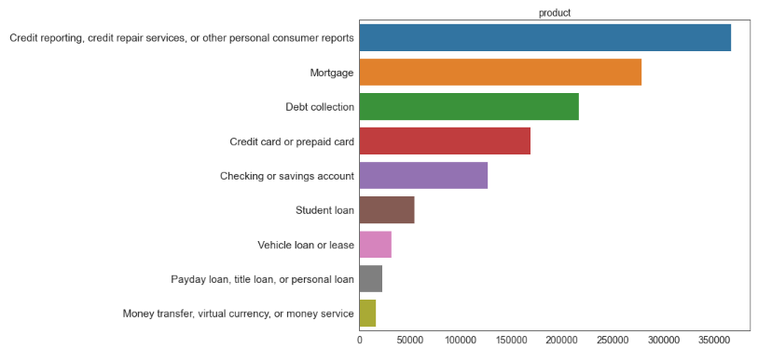
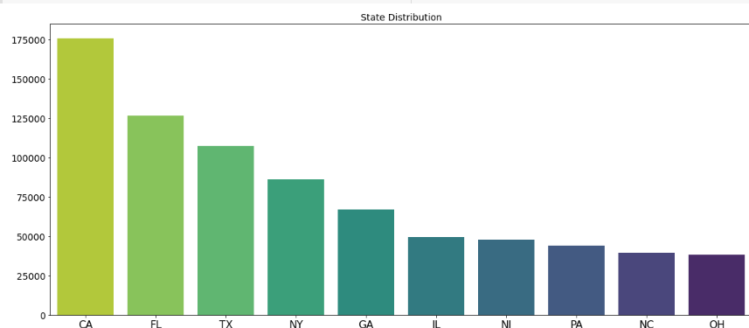
EDA
PROBLEMS & OPPORTUNITIES 1.0
Uneven spread of issue across state
High issue from specific product

Slide 8
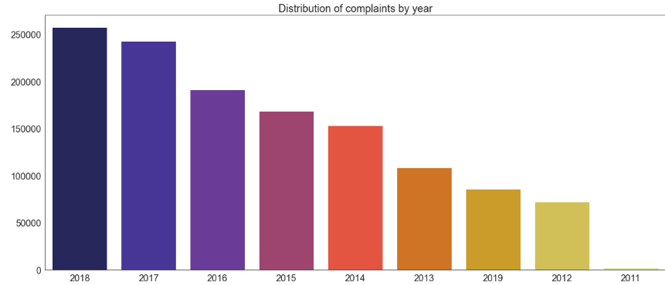
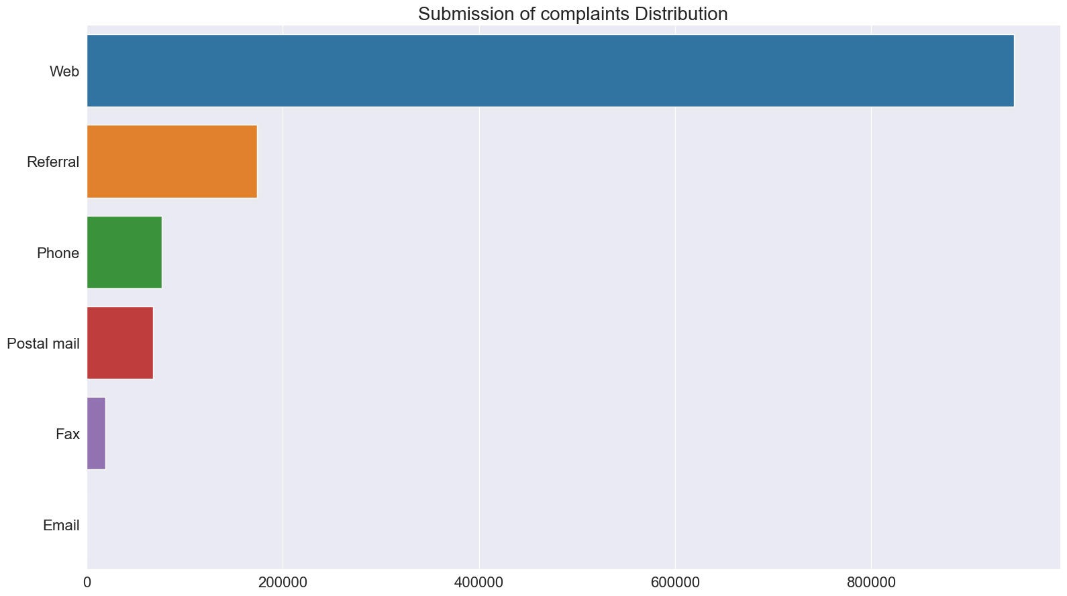
EDA
PROBLEMS & OPPORTUNITIES 1.1
Periodic Increase In Issue
Complaints log

Slide 9

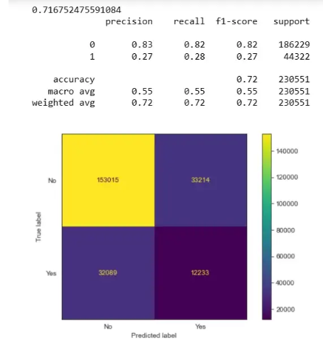

MODEL CLASSIFICATION
Model selection and testing

Slide 10
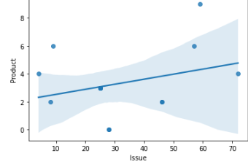
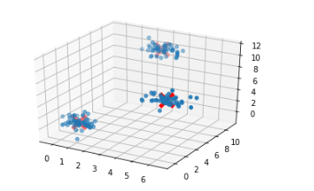
Regression Analysis
CONCLUSION 1.0
locates the different modes of the data and shift every data point towards the mean cluster, telling us there is a commonality of some sorts
slight positive linear correlation between Product and Issue is evident

Slide 11
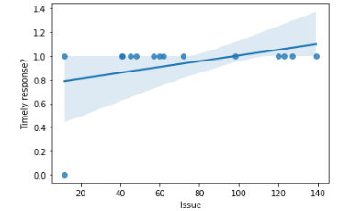
Regression Analysis
CONCLUSION 1.1
Very slight positive linear correlation between timely responses and issue

Slide 12

Final Recommendation 1.2
Further investigation to know which specific issues are more common with which financial products
→ allowing consumer support employees to be better prepared to support consumers

